Slide 1
RDKit UGM 2022
Overview by Ash, Helge, Marcel and Son

Slide 2
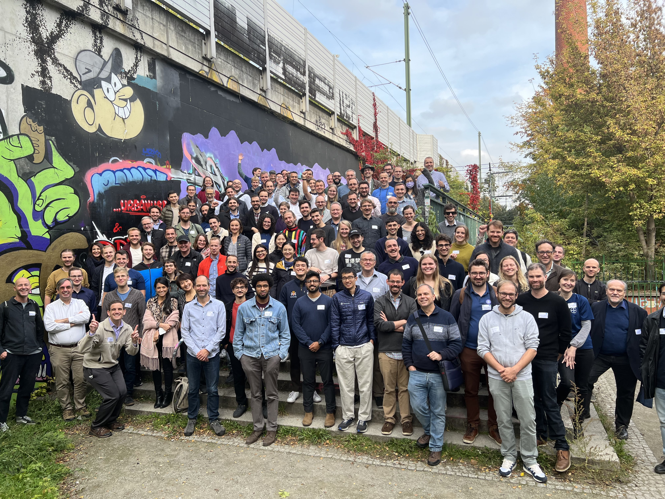
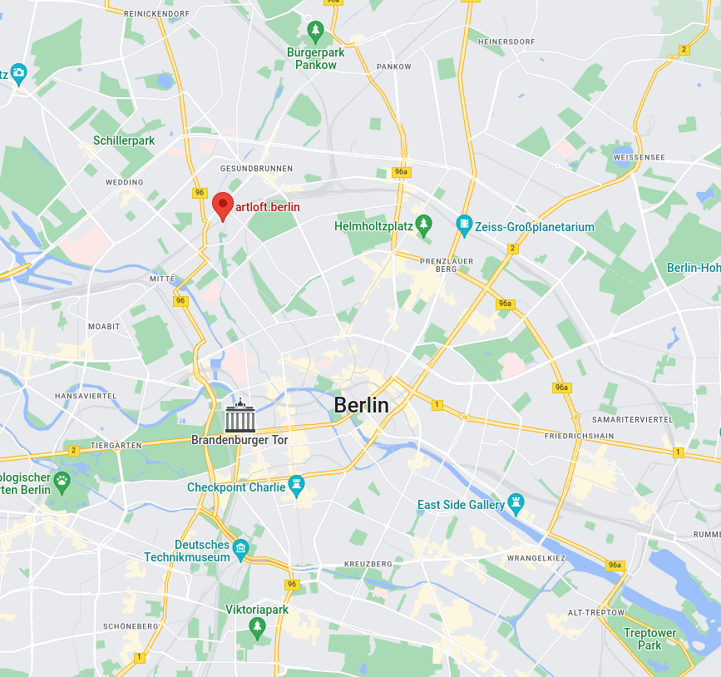
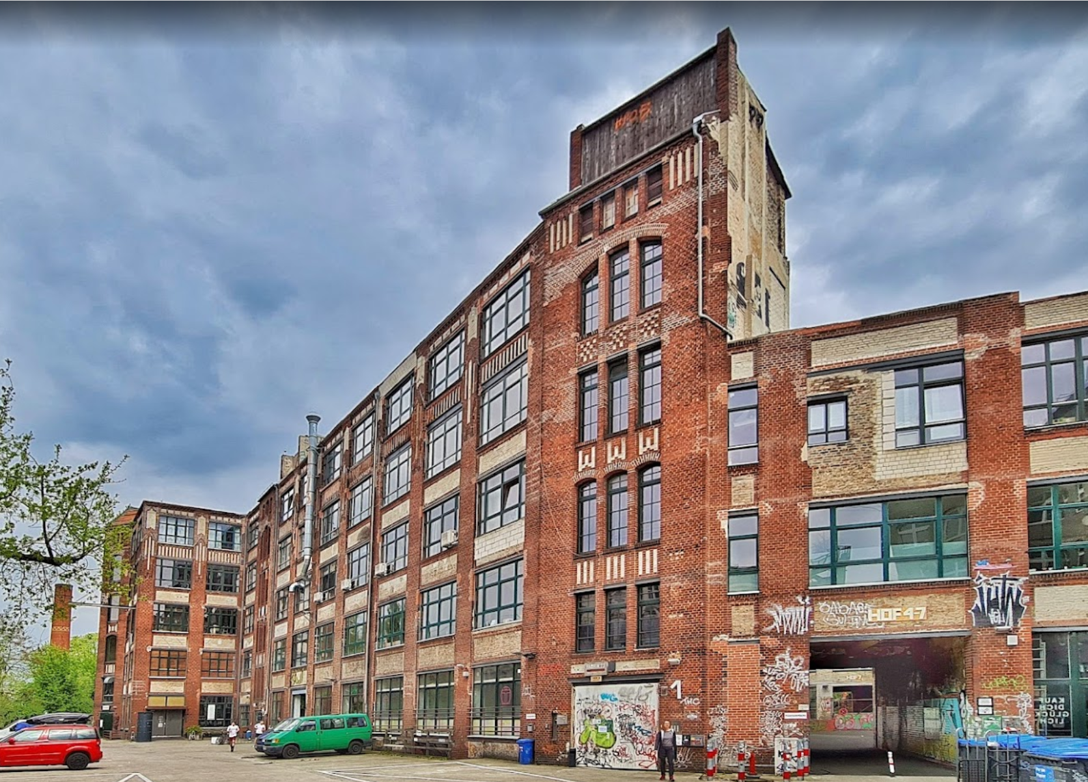
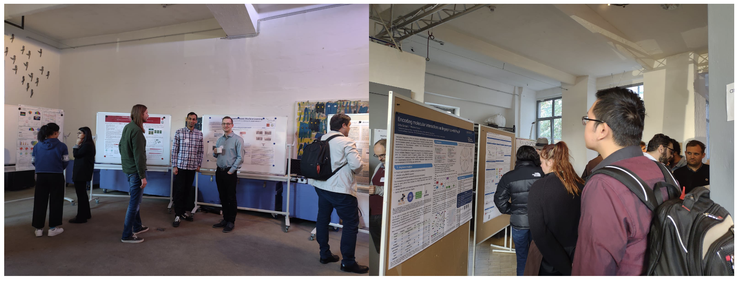
Key Notes
When: 12. – 14.10.2022
Where: artloft.berlin
~130 in person attendies
~500 virtual attendies
28.10.2022 – Marcel Baltruschat

Slide 3
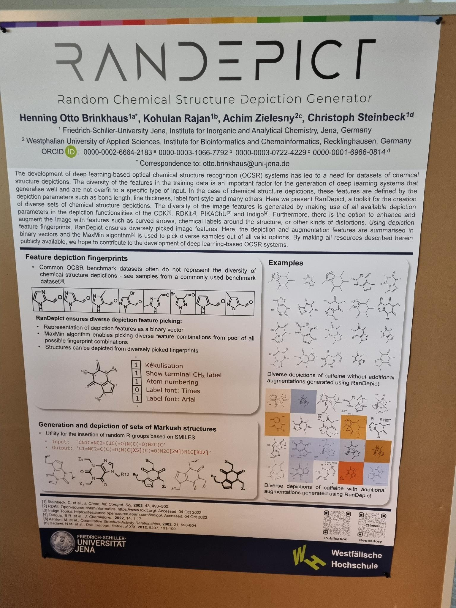
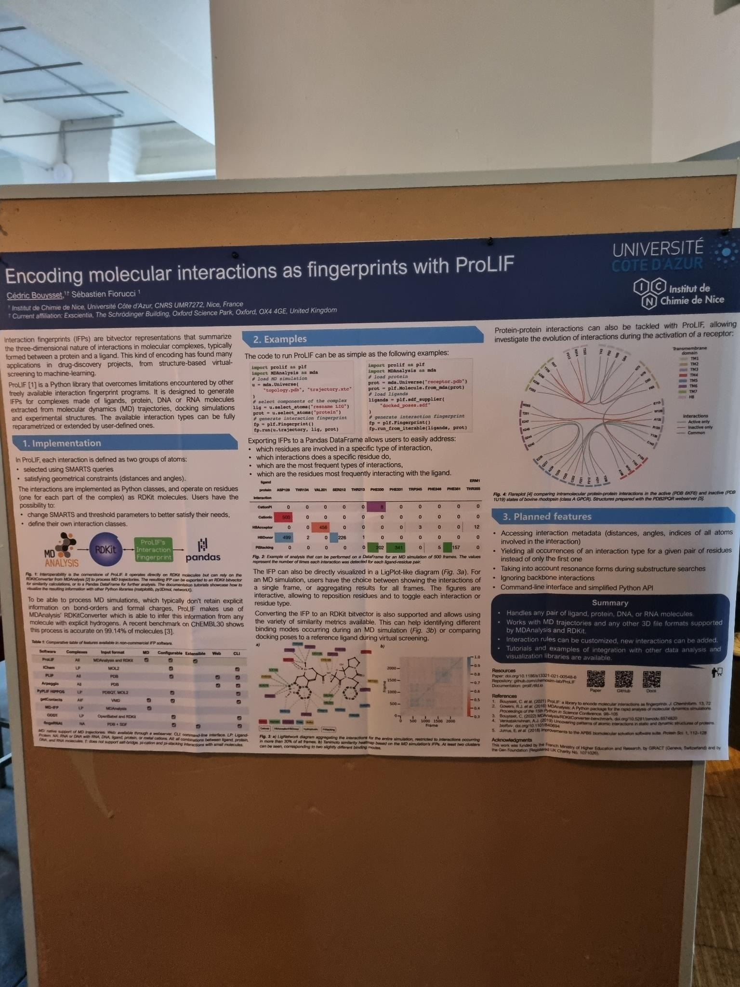
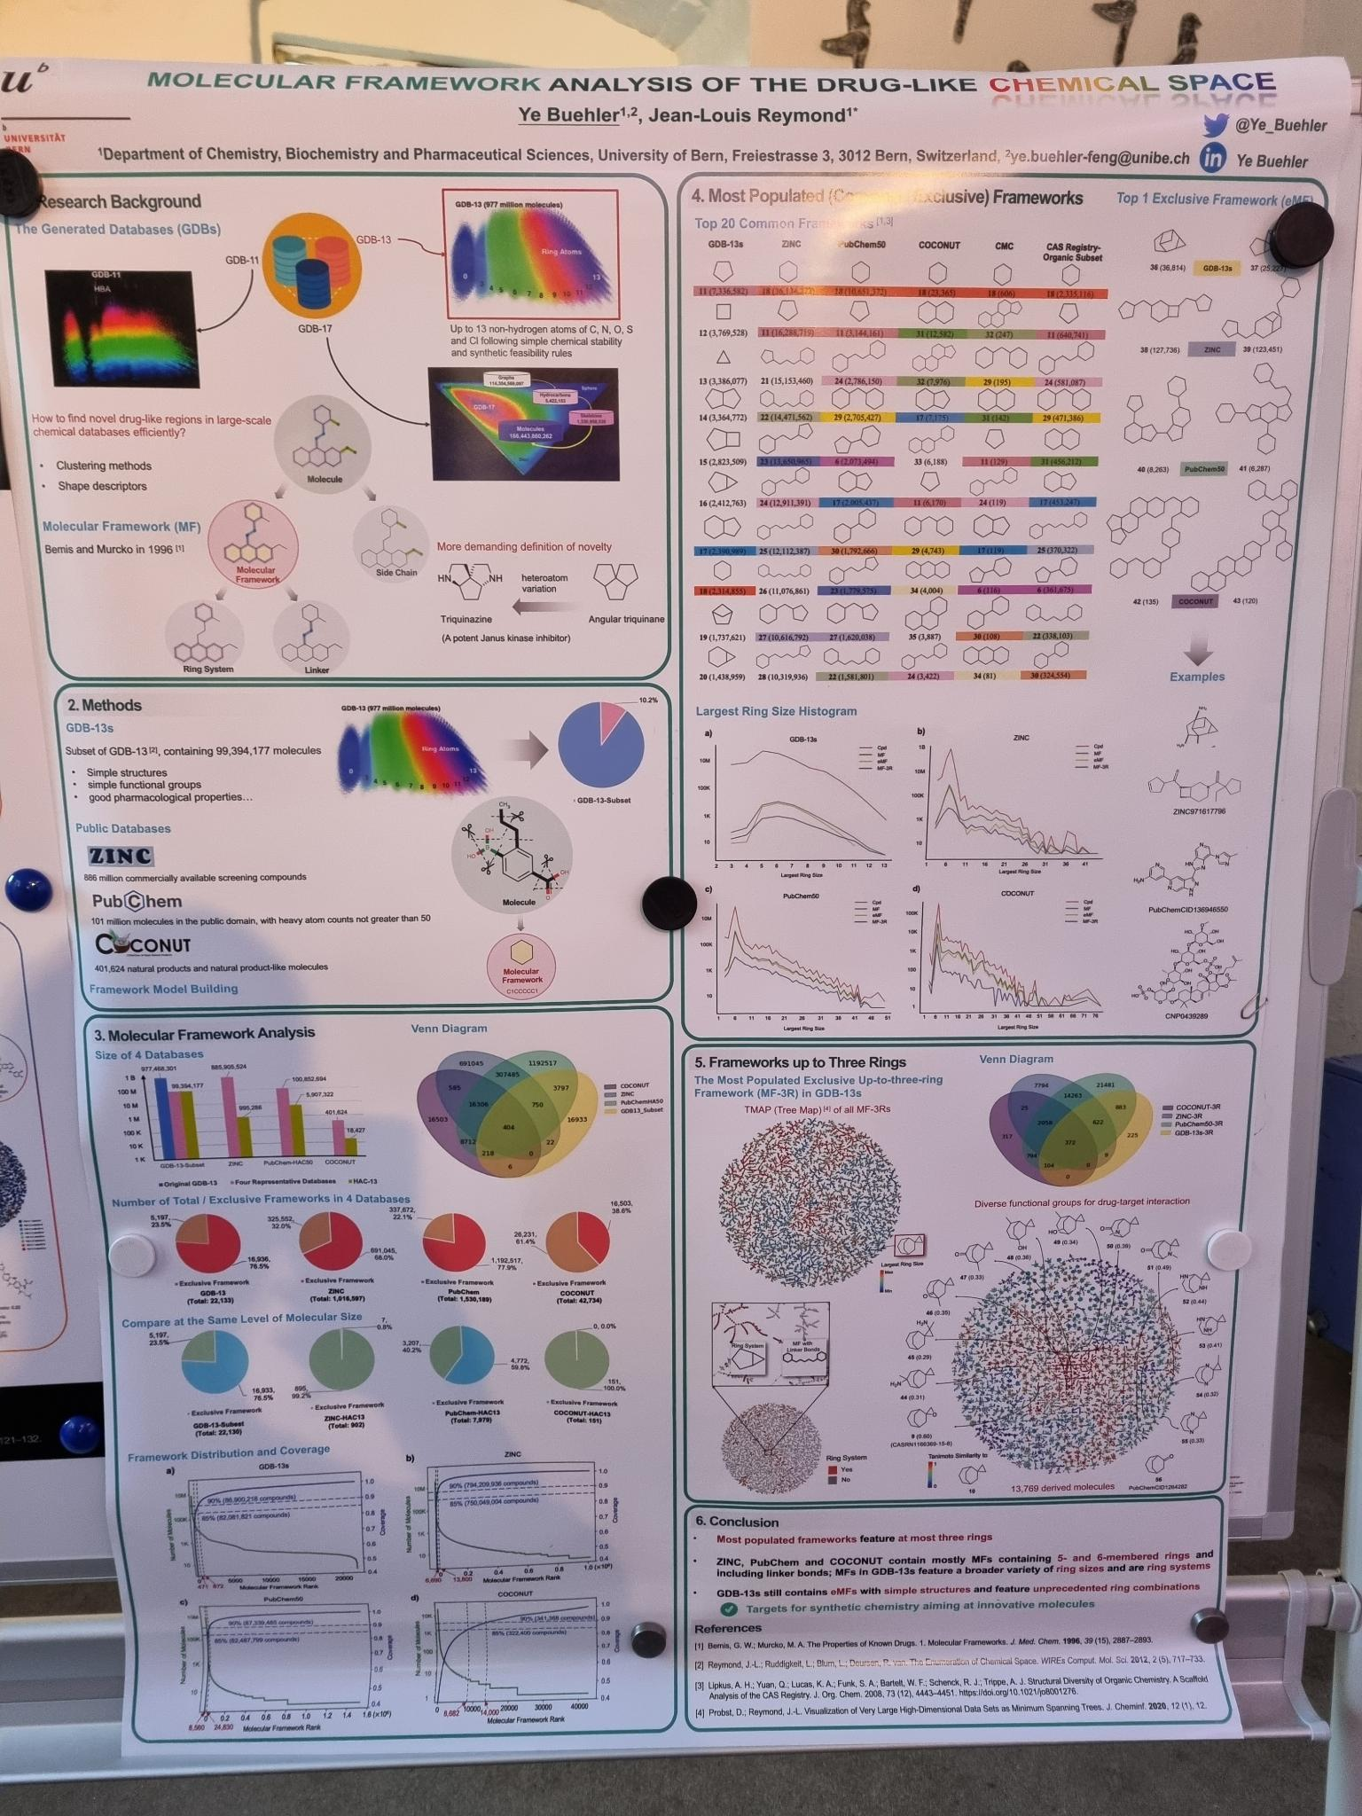
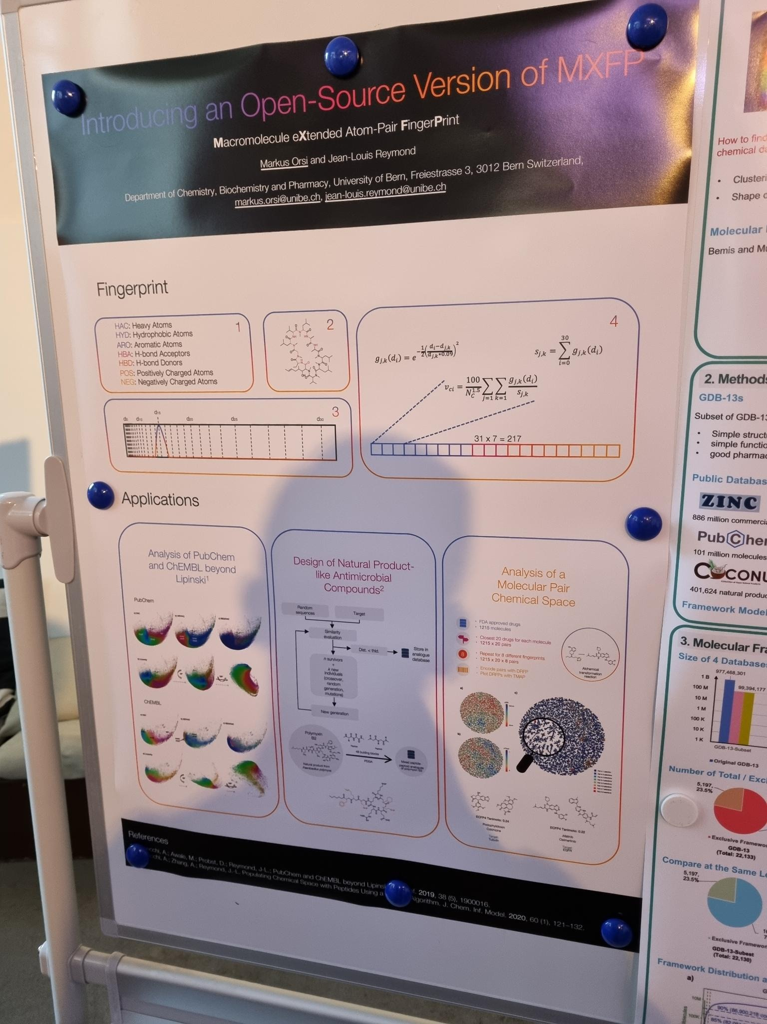
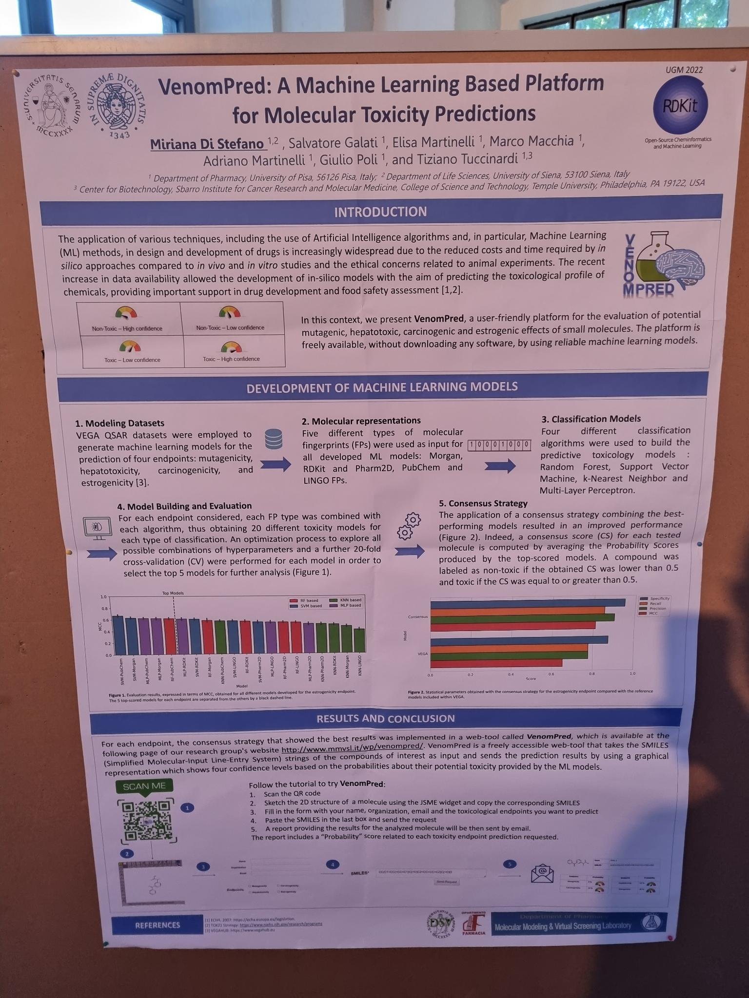
Posters
28.10.2022 – Marcel Baltruschat

Slide 4
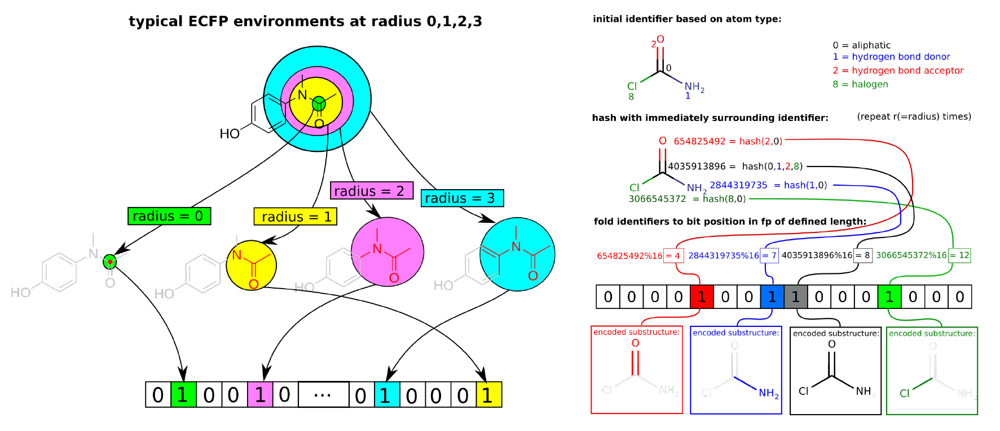
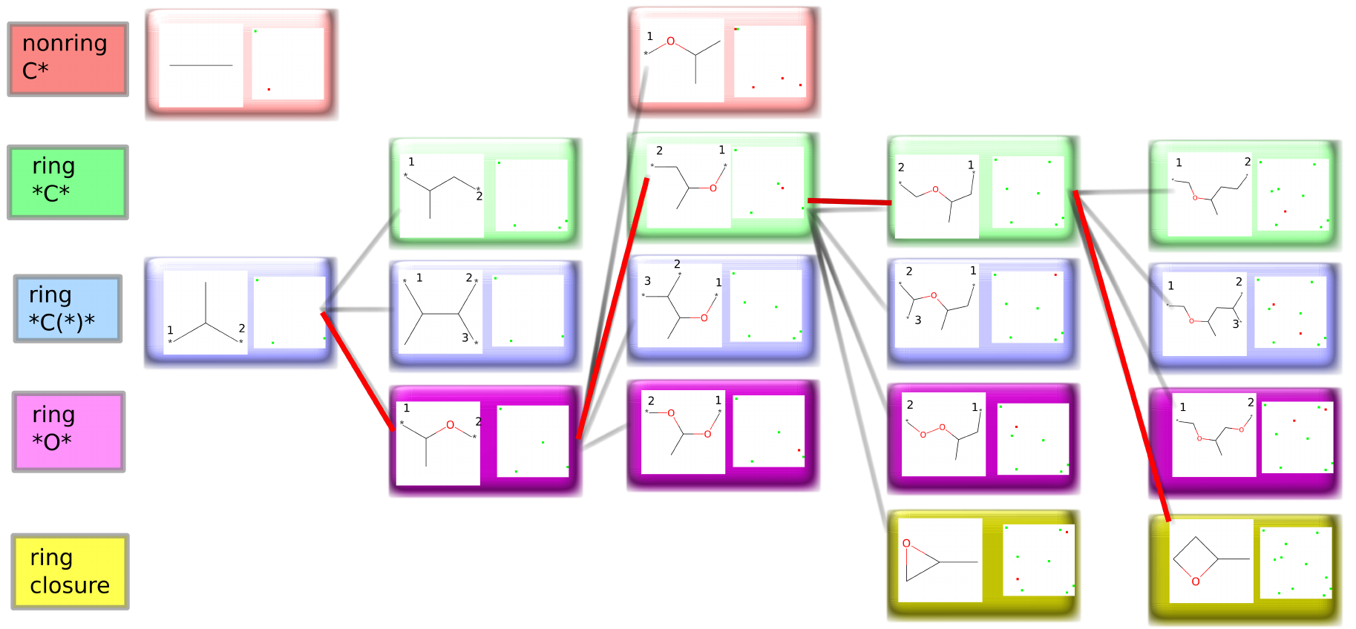
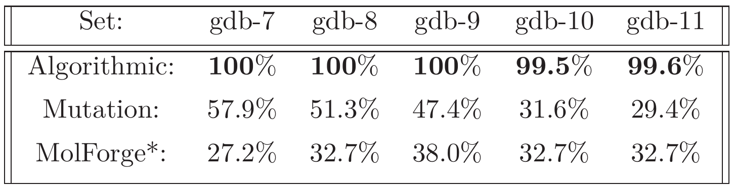
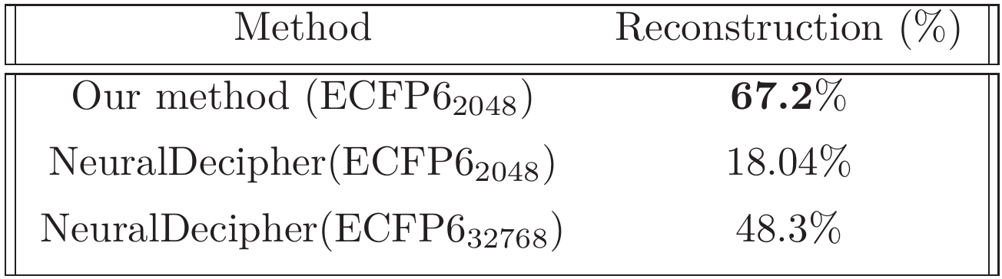
Inverting circular fingerprints algorithmically
https://www.dropbox.com/s/mx3k4mepa7hm8tb/ECFPInvert_RDKIT_UGM_poster.pdf
28.10.2022 – Marcel Baltruschat

Slide 5

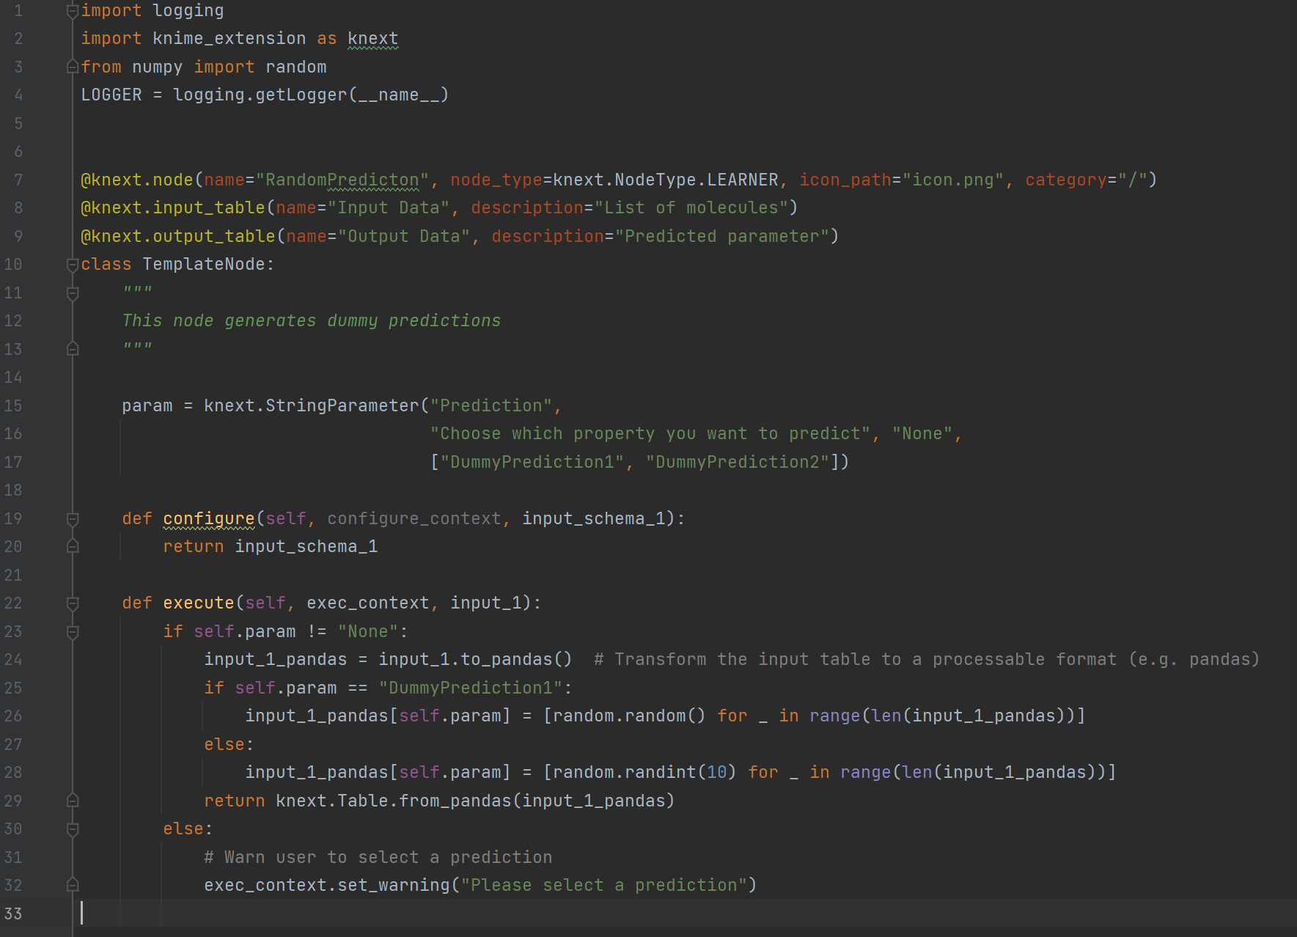
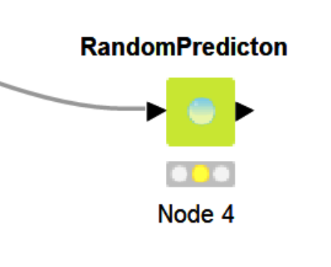
Hackathon - KNIME Nodes in Python
Setup and tutorial explained here: https://docs.knime.com/latest/pure_python_node_extensions_guide/#introduction
28.10.2022 – Helge Vatheuer

Slide 6
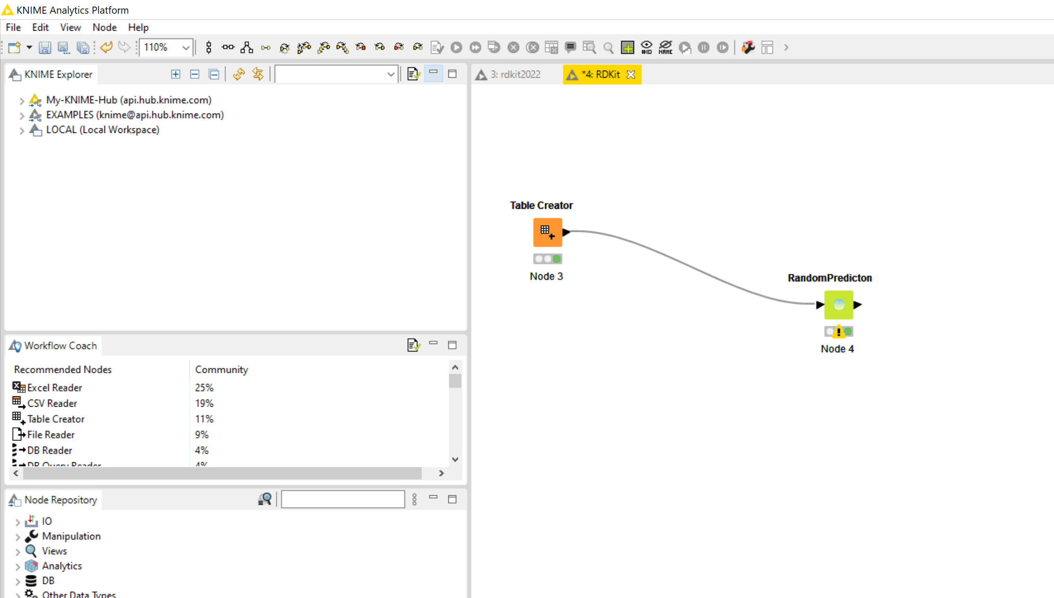
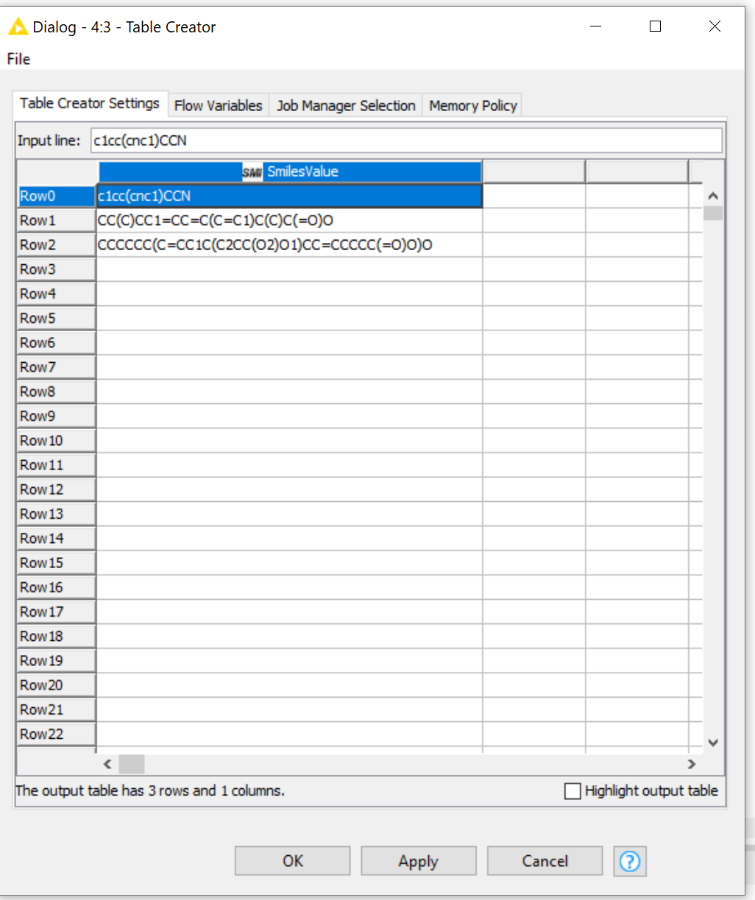
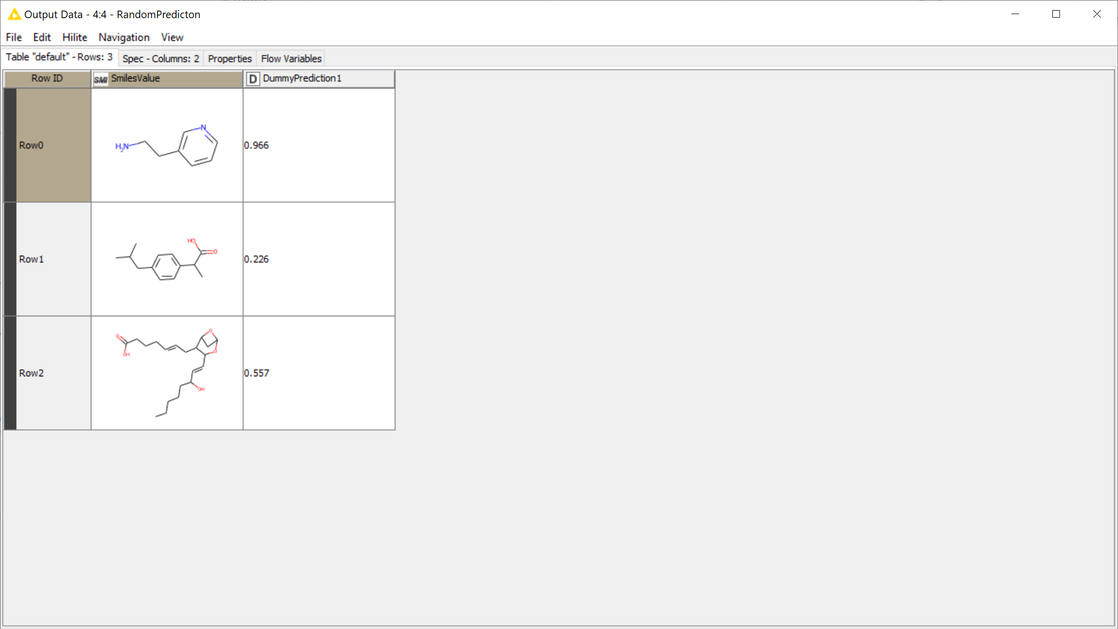
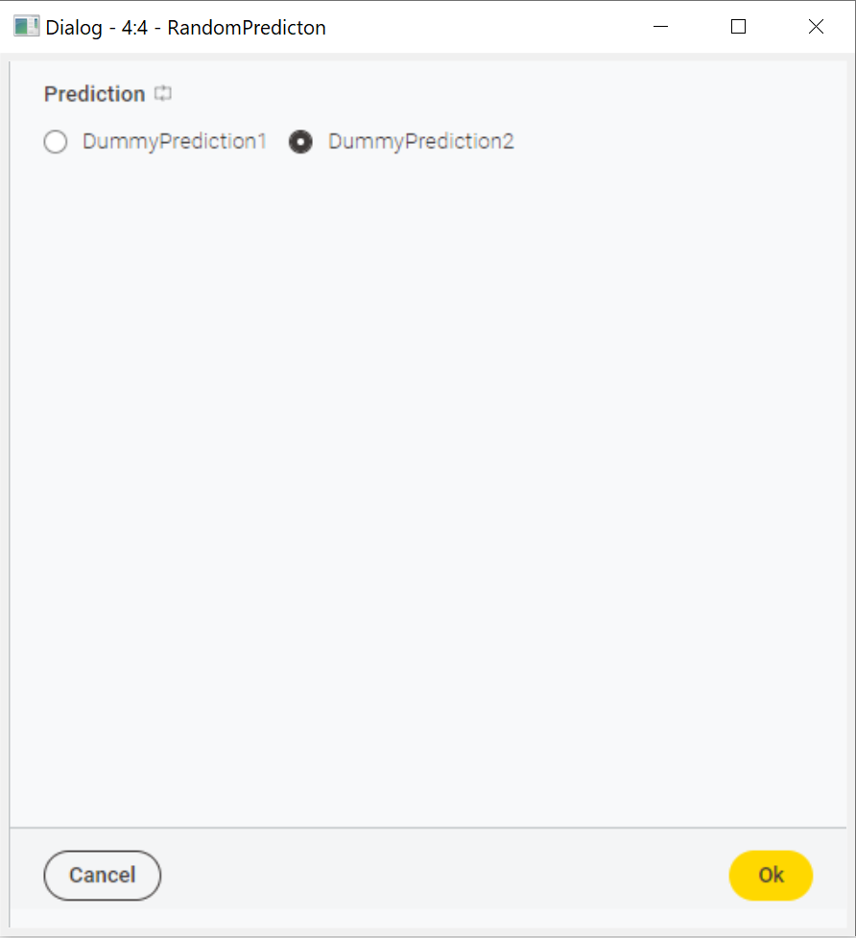
Hackathon - KNIME Nodes in Python
28.10.2022 – Helge Vatheuer

Slide 7

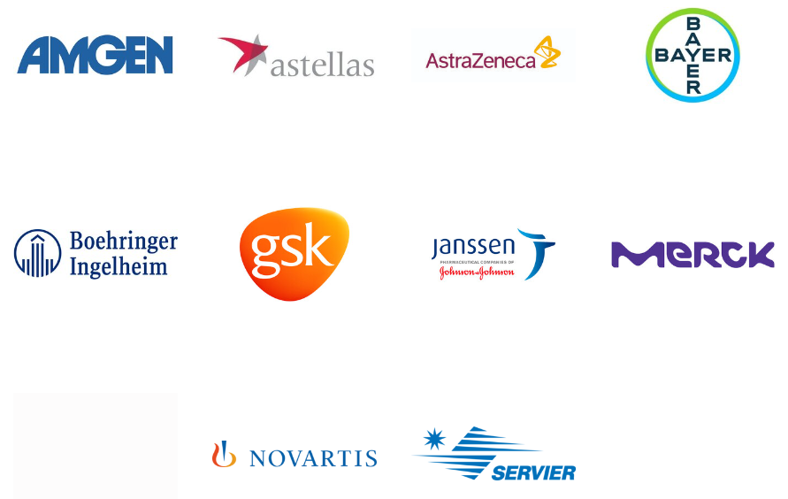
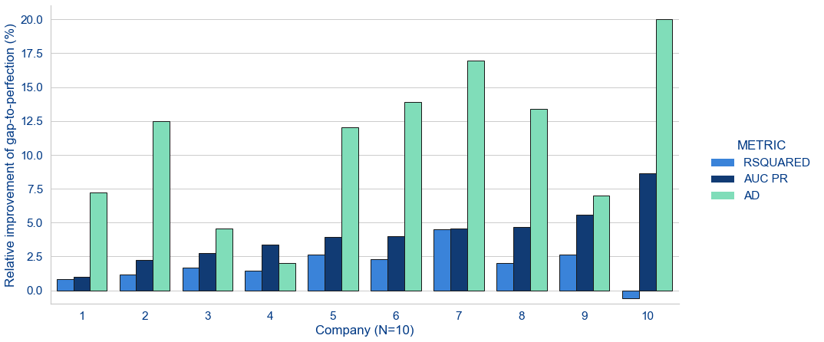
Son’s talk highlight
MELLODDY Consortium: Training a model cross-pharma without compromising proprietary information.
Landmark achievement in federated learning.
Some interesting details:
Model is trained without pharma sharing data with each other.
The model is designed such that it encourages pharma to share data.
Some stats:
2.6+ billion confidential experimental activity data points,
Documenting 21+ million physical small molecules and 40+ thousand assays in on-target and secondary pharmacodynamics and pharmacokinetics.
https://chemrxiv.org/engage/chemrxiv/article-details/6345c0f91f323d61d7567624
28.10.2022 – Son Ha

Slide 8
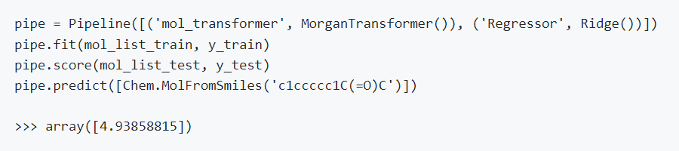
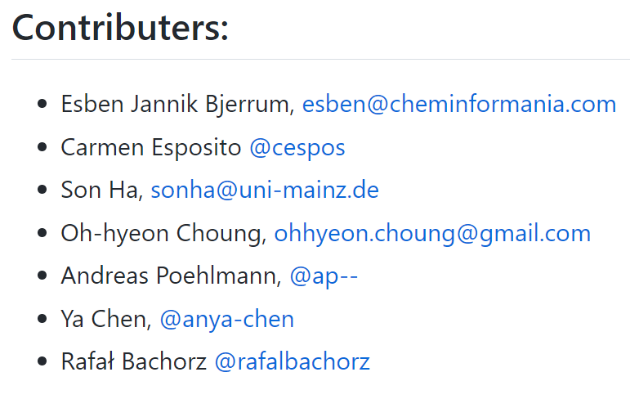
Son’s hackathon highlight
Scikit-mol: Scikit-Learn classes for molecular vectorization using RDKit.
Benefit:
Make Sklearn works directly with SMILES strings or RDKit mol, without external fingerprinting steps.
Make RDKit molecule transformers (and other utils) Sklearn-compatible.
GitHub link: https://github.com/EBjerrum/scikit-mol (Still in beta)

Slide 9
Thank you for your attention!

